Slide 1
Protection of Microdata
SDC COURSE 2025

Slide 2
Course Introduction

Slide 3
SDC Theory Guide
Screenshot from https://sdctheory.readthedocs.io/en/latest/

Slide 4

Statistical Disclosure Control
for Microdata
Book by Matthias Templ
Matthias Templ is the main author and maintainer of sdcMicro
The book contains both theory and sdcMicro code examples

Slide 5

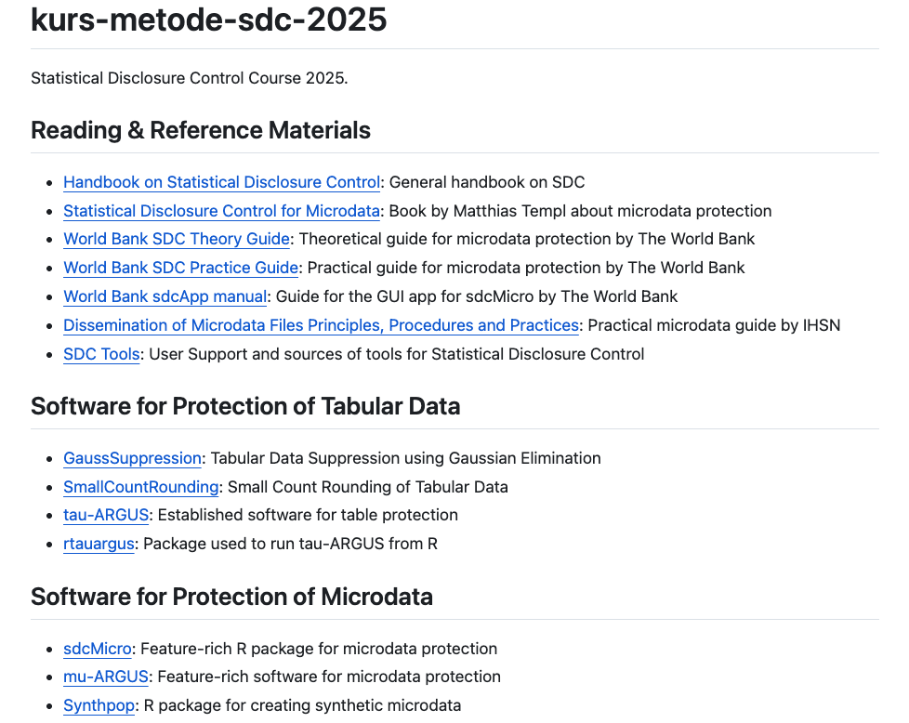
Course Resources
Screenshot from https://github.com/statisticsnorway/kurs-metode-sdc-2025

Slide 6
Agenda
Motivation and Overview
Classification of Variables
Risk Measures
Anonymization Methods
Utility Measures

Slide 7
Motivation and Overview

Slide 8

Identity Disclosure
When an intruder correctly links a released data record to a specific individual
Gender: F
Birth year: 1996
Occupation: Investor
Nationality: Norwegian
E-mail: jan_krog@...
Occupation: Prime minister
Person ID | E-mail | Gender | Birth year | Occupation | Nationality | Income | Job satisfaction
2102… | jan_krog@... | M | 1950 | Researcher | Norwegian | 42000 | Low
2306… | anna_m@... | F | 1983 | Student | German | 0 | Medium
0105… | lise96@... | F | 1996 | Investor | Norwegian | 349000 | High
2412… | jonas60@... | M | 1960 | Prime minister | Norwegian | 53000 | High
1705… | oliviahh@... | F | 2004 | Student | Norwegian | 0 | High
2308… | jrk@... | M | 1951 | Researcher | Norwegian | 39000 | Low
… | … | … | … | … | … | … | …

Slide 9
Attribute Disclosure
When an intruder learns new information (an attribute) about an individual based on the released data
Identity disclosure leads to attribute disclosure
However, attribute disclosure can happen without identity disclosure
Occupation: Researcher
Nationality: Norwegian
Job satisfaction: Low
Person ID | E-mail | Gender | Birth year | Occupation | Nationality | Income | Job satisfaction
2102… | jan_krog@... | M | 1950 | Researcher | Norwegian | 42000 | Low
2306… | anna_m@... | F | 1983 | Student | German | 0 | Medium
0105… | lise96@... | F | 1996 | Investor | Norwegian | 349000 | High
2412… | jonas60@... | M | 1960 | Prime minister | Norwegian | 53000 | High
1705… | oliviahh@... | F | 2004 | Student | Norwegian | 0 | High
2308… | jrk@... | M | 1951 | Researcher | Norwegian | 39000 | Low
… | … | … | … | … | … | … | …

Slide 10
Inferential Disclosure
Occupation: Student
When an intruder can use the released data to more accurately (but not precisely) predict information about an individual
Income: ≈0
95% of students have income of 0
Person ID | E-mail | Gender | Birth year | Occupation | Nationality | Income | Job satisfaction
2102… | jan_krog@... | M | 1950 | Researcher | Norwegian | 42000 | Low
2306… | anna_m@... | F | 1983 | Student | German | 0 | Medium
0105… | lise96@... | F | 1996 | Investor | Norwegian | 349000 | High
2412… | jonas60@... | M | 1960 | Prime minister | Norwegian | 53000 | High
1705… | oliviahh@... | F | 2004 | Student | Norwegian | 0 | High
2308… | jrk@... | M | 1951 | Researcher | Norwegian | 39000 | Low
… | … | … | … | … | … | … | …

Slide 11
Anonymize Before Release!
Common techniques:
Remove variables
Suppress cells
Recode values
Swap values
Add numerical noise to values
…
Anonymization reduces both risk and utility
Person ID
2102…
2306…
0105…
2412…
1705…
2308…
Gender
<NA>
F
F
<NA>
F
M
Gender | Birth year | Nationality | Income
M | 1950 | Norwegian | 42000
F | 1943 | German | 49000
F | 1996 | Norwegian | 349000
M | 1960 | Norwegian | 53000
F | 2004 | Norwegian | 0
M | 1951 | Norwegian | 39000
Birth year
<2000
<2000
<2000
<2000
>2000
<2000
Nationality
Norwegian
Norwegian
Norwegian
Norwegian
German
Norwegian
Income
45572
51543
341452
58898
1055
44137

Slide 12
Five Safes Framework
Who gets access to the data?
What are the legal obligations of the users?
What are the users intending to do with the data?
In which environment does the users interact with the data?
Does the environment enforce any restrictions on usage?
What is the data about?
How detailed/sensitive is the data?
To which degree is the data anonymized?
What types of output can be produced from the data?
Safe People
Safe Projects
Safe Settings
Safe Data
Safe Outputs
Five Safes: designing data access for research, T. Desai, F. Ritchie and R. Welpton

Slide 13
Release Types
Release type | Use case | Degree of anonymization
Raw microdata | Internal use | None
SecUF (Secure Use Files) | Controlled, secure environments | Low
SUF (Scientific Use File) | Microdata to researchers | Medium
PUF (Public Use File) | Microdata to the public | High

Slide 14
Statistical Disclosure Control (SDC) for Microdata
Apply
Anonymization Methods
Evaluate
Risk
Evaluate
Utility

Slide 15
The Anonymization Process
Original dataset
Risk
Highest acceptable risk
Optimal solution
No data
Utility

Slide 16
Classification of Variables

Slide 17
Classification of Variables
How identifying is each variable?
How sensitive is each variable?
How is each variable measured and represented?
For surveys, what is the weight variable?
For surveys, what are the stratification variables?

Slide 18
How Identifying is the Variable?
Identifying variables
Non-identifying variables
Survey responses
Product ratings
Job satisfaction
Non-visible medical condition
Direct identifiers
Quasi-identifiers
(key variables)
Passport number
Social identity number
Name
Phone number
Address
E-mail
Organizational ID
Gender
Birth date/year
Marital status
Nationality
Race
Occupation
Education
ZIP/postal codes
City of residence

Slide 19
How Identifying is the Variable?
Quasi-identifiers
(key variables)
Direct identifiers
Non-identifying
Person ID | E-mail | Gender | Birth year | Occupation | Nationality | Income | Job satisfaction | Weight
2102… | jan_krog@... | M | 1950 | Researcher | Norwegian | 42000 | Low | 20
2306… | anna_m@... | F | 1943 | Researcher | German | 49000 | Medium | 35
0105… | lise96@... | F | 1996 | Investor | Norwegian | 349000 | High | 10
2412… | jonas60@... | M | 1960 | Prime minister | Norwegian | 53000 | High | 15
1705… | oliviahh@... | F | 2004 | Student | Norwegian | 0 | High | 40
2308… | jrk@... | M | 1951 | Researcher | Norwegian | 39000 | Low | 20
… | … | … | … | … | … | … | … | …

Slide 20
How Sensitive is the Variable?
Sensitive variables
Non-sensitive variables
Income
Religion
Political affiliation
Medical record
Criminal record
Sexual orientation
Drug addiction
Urban/rural residence
House color

Slide 21
How Sensitive is the Variable?
(Sensitive)
Non-sensitive
Sensitive
Person ID | E-mail | Gender | Birth year | Occupation | Nationality | Income | Job satisfaction | Weight
2102… | jan_krog@... | M | 1950 | Researcher | Norwegian | 42000 | Low | 20
2306… | anna_m@... | F | 1943 | Researcher | German | 49000 | Medium | 35
0105… | lise96@... | F | 1996 | Investor | Norwegian | 349000 | High | 10
2412… | jonas60@... | M | 1960 | Prime minister | Norwegian | 53000 | High | 15
1705… | oliviahh@... | F | 2004 | Student | Norwegian | 0 | High | 40
2308… | jrk@... | M | 1951 | Researcher | Norwegian | 39000 | Low | 20
… | … | … | … | … | … | … | … | …

Slide 22
How is the Variable Measured and Represented?
Categorical variables
Semi-continuous variables
Continuous variables
Gender
Name
Marital status
Nationality
Occupation
Blood type
Eye color
Job satisfaction level (1-5)
Age levels
Salary
Revenue
Height
Weight
Temperature

Slide 23
How is the Variable Measured and Represented?
Semi-continuous
Continuous
Person ID | E-mail | Gender | Birth year | Occupation | Nationality | Income | Job satisfaction | Weight
2102… | jan_krog@... | M | 1950 | Researcher | Norwegian | 42000 | Low | 20
2306… | anna_m@... | F | 1943 | Researcher | German | 49000 | Medium | 35
0105… | lise96@... | F | 1996 | Investor | Norwegian | 349000 | High | 10
2412… | jonas60@... | M | 1960 | Prime minister | Norwegian | 53000 | High | 15
1705… | oliviahh@... | F | 2004 | Student | Norwegian | 0 | High | 40
2308… | jrk@... | M | 1951 | Researcher | Norwegian | 39000 | Low | 20
… | … | … | … | … | … | … | … | …

Slide 24
How is the Variable Measured and Represented?
Categorical
Person ID | E-mail | Gender | Birth year | Occupation | Nationality | Income | Job satisfaction | Weight
2102… | jan_krog@... | M | 1950 | Researcher | Norwegian | 42000 | Low | 20
2306… | anna_m@... | F | 1943 | Researcher | German | 49000 | Medium | 35
0105… | lise96@... | F | 1996 | Investor | Norwegian | 349000 | High | 10
2412… | jonas60@... | M | 1960 | Prime minister | Norwegian | 53000 | High | 15
1705… | oliviahh@... | F | 2004 | Student | Norwegian | 0 | High | 40
2308… | jrk@... | M | 1951 | Researcher | Norwegian | 39000 | Low | 20
… | … | … | … | … | … | … | … | …

Slide 25
Stratification and Weighting
Stratification variables
Weight variable
Person ID | E-mail | Gender | Birth year | Occupation | Nationality | Income | Job satisfaction | Weight
2102… | jan_krog@... | M | 1950 | Researcher | Norwegian | 42000 | Low | 20
2306… | anna_m@... | F | 1943 | Researcher | German | 49000 | Medium | 35
0105… | lise96@... | F | 1996 | Investor | Norwegian | 349000 | High | 10
2412… | jonas60@... | M | 1960 | Prime minister | Norwegian | 53000 | High | 15
1705… | oliviahh@... | F | 2004 | Student | Norwegian | 0 | High | 40
2308… | jrk@... | M | 1951 | Researcher | Norwegian | 39000 | Low | 20
… | … | … | … | … | … | … | … | …

Slide 26
Delete Direct Identifiers!
Direct identifiers (like name or address) should never be released!
This is done to prevent direct linking between a record and the individual
Special IDs can be used for datasets when matching should be allowed
Identity disclosure then requires matching on key variables
Anonymization requires changes to the key variables

Slide 27
Delete Direct Identifiers!
Quasi-identifiers
(key variables)
Direct identifiers
Person ID | E-mail | Gender | Birth year | Occupation | Nationality | Income | Job satisfaction | Weight
2102… | jan_krog@... | M | 1950 | Researcher | Norwegian | 42000 | Low | 20
2306… | anna_m@... | F | 1943 | Researcher | German | 49000 | Medium | 35
0105… | lise96@... | F | 1996 | Investor | Norwegian | 349000 | High | 10
2412… | jonas60@... | M | 1960 | Prime minister | Norwegian | 53000 | High | 15
1705… | oliviahh@... | F | 2004 | Student | Norwegian | 0 | High | 40
2308… | jrk@... | M | 1951 | Researcher | Norwegian | 39000 | Low | 20
… | … | … | … | … | … | … | … | …

Slide 28
Delete Direct Identifiers!
Now, only the key variables can be used for identity disclosure
Quasi-identifiers
(key variables)
Gender | Birth year | Occupation | Nationality | Income | Job satisfaction | Weight
M | 1950 | Researcher | Norwegian | 42000 | Low | 20
F | 1943 | Researcher | German | 49000 | Medium | 35
F | 1996 | Investor | Norwegian | 349000 | High | 10
M | 1960 | Prime minister | Norwegian | 53000 | High | 15
F | 2004 | Student | Norwegian | 0 | High | 40
M | 1951 | Researcher | Norwegian | 39000 | Low | 20
… | … | … | … | … | … | …

Slide 29
Risk Measures

Slide 30
Statistical Disclosure Control (SDC) for Microdata
Apply
Anonymization Methods
Evaluate
Risk
Evaluate
Utility

Slide 31
Sample Frequency f_{k}
Consider each combination k of key variables:
Each such combination is called a key
Let f_{k} be the number of units in sample with a key = k
Occupation: {Professor, Researcher} → Academic
Gender | Occupation | f_{k}
M | Professor | 1
F | Investor | 3
F | Software Engineer | 2
F | Investor | 3
M | Researcher | 1
F | Software Engineer | 2
F | Investor | 3
Gender | Occupation | f_{k}
M | Academic | 2
F | Investor | 3
F | Software Engineer | 2
F | Investor | 3
M | Academic | 2
F | Software Engineer | 2
F | Investor | 3
Recode

Slide 32
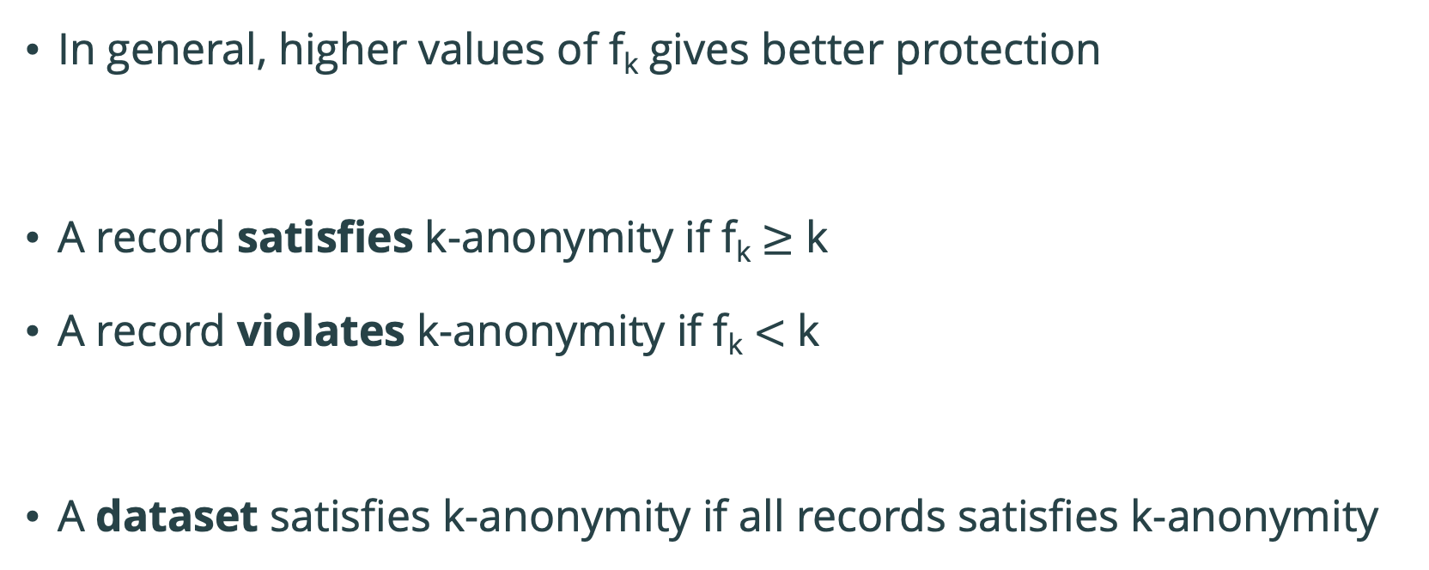
Risk Measure: k-anonymity
In general, higher values of f_{k} gives better protection
A record satisfies k-anonymity if f_{k} $≥$ k
A record violates k-anonymity if f_{k} $<$ k
A dataset satisfies k-anonymity if all records satisfies k-anonymity

Slide 33
Risk Measure: k-anonymity — Example
Gender | Occupation | f_{k}
F | Investor | 3
F | Investor | 3
F | Investor | 3
M | Professor | 2
M | Professor | 2
M | Researcher | 2
M | Researcher | 2
Gender | Occupation | f_{k}
F | Investor | 3
F | Investor | 3
F | Investor | 3
M | Academic | 4
M | Academic | 4
M | Academic | 4
M | Academic | 4
Recode
Satisfies 2-anonymity
Violates 3-anonymity
Number of records violating
2-anonymity: 0 (0.000%)
3-anonymity: 4 (57.143%)
5-anonymity: 7 (100.000%)
Number of records violating
2-anonymity: 0 (0.000%)
3-anonymity: 0 (0.000%)
5-anonymity: 7 (100.000%)

Slide 34
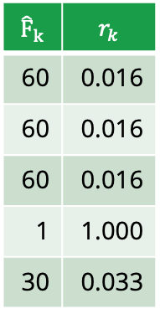
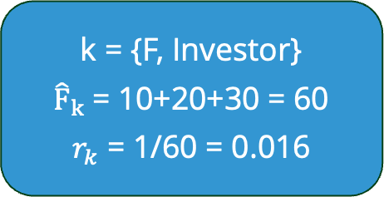

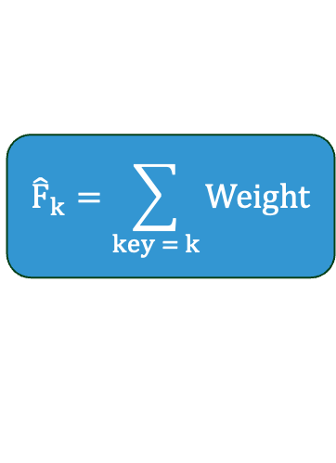
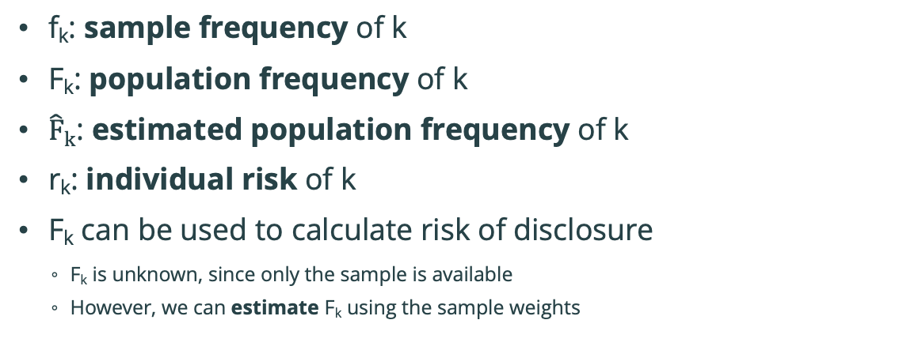
Population Frequency F_{k}
f_{k}: sample frequency of k
F_{k}: population frequency of k
${\hat{F}}_{k}$: estimated population frequency of k
r_{k}: individual risk of k
F_{k} can be used to calculate risk of disclosure
F_{k} is unknown, since only the sample is available
However, we can estimate F_{k} using the sample weights
$${\hat{F}}_{k}=\sum_{key = k}{Weight}$$
$$r_{k}=\frac{1}{{\hat{F}}_{k}}$$
Population (100 records)
Gender | Occupation | F_{k}
F | Investor | 50
F | Investor | 50
M | Professor | 10
F | Investor | 50
M | Researcher | 30
F | Software Engineer | 5
F | Investor | 50
M | Software Engineer | 5
M | Prime Minister | 1
… | … | …
(more sophisticated risk formulas exist)
Sample (5 records)
Weight | Gender | Occupation | f_{k}
10 | F | Investor | 3
20 | F | Investor | 3
30 | F | Investor | 3
1 | M | Prime Minister | 1
39 | M | Researcher | 1
$${\hat{F}}_{k}$$ | $$r_{k}$$
60 | 0.016
60 | 0.016
60 | 0.016
1 | 1.000
30 | 0.033
k = {F, Investor}
${\hat{F}}_{k}$= 10+20+30 = 60
$r_{k}$ = 1/60 = 0.016

Slide 35
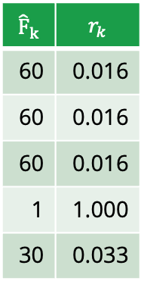
Global Risk Measures
1. Expected number of reidentifications:
sum(r_{k}) = 0.016+0.016+0.016+1.000+0.033 = 1.081
2. Expected fraction of reidentified records:
mean(r_{k}) = 1.081/5 = 0.21
3. Expected percentage of reidentified records:
100 * mean(r_{k}) = 100 * 0.21 = 21
4. Risk of most vulnerable record:
max(r_{k}) = 1.000
Sample (5 records)
Weight | Gender | Occupation | f_{k}
10 | F | Investor | 3
20 | F | Investor | 3
30 | F | Investor | 3
1 | M | Professor | 1
39 | M | Researcher | 1
$${\hat{F}}_{k}$$ | $$r_{k}$$
60 | 0.016
60 | 0.016
60 | 0.016
1 | 1.000
30 | 0.033

Slide 36
Risk Measures – More Information
l-diversity: an extension of k-anonymity
Prevents attribute disclosure
Ensures that there is variety in sensitive variables for records with the same key
SUDA: A more advanced frequency-based risk measure
Considers uniqueness also in subsets of key variables
Risk measures for perturbative methods
f_{k} can not be used in these cases
Distance-based measures are used instead

Slide 37
Anonymization Methods

Slide 38
Statistical Disclosure Control (SDC) for Microdata
Apply
Anonymization Methods
Evaluate
Risk
Evaluate
Utility

Slide 39
Anonymization Methods — Overview
Anonymization method | Classification | Data type
Remove variables | Non-perturbative, deterministic | Continuous and categorical
Global recoding | Non-perturbative, deterministic | Continuous and categorical
Top and bottom coding | Non-perturbative, deterministic | Continuous
Rounding | Non-perturbative, deterministic | Continuous
Local suppression | Non-perturbative, deterministic | Categorical
PRAM | Perturbative, probabilistic | Categorical
Micro aggregation | Perturbative, probabilistic | Continuous
Noise addition | Perturbative, probabilistic | Continuous
Rank swapping | Perturbative, probabilistic | Continuous
Shuffling | Perturbative, probabilistic | Continuous

Slide 40
Remove Variables
Remove one or more variables before release
Used on direct identifiers to avoid straightforward identity disclosure
Used on quasi-identifiers (key variables) for additional prevention of identification
Used occasionally on sensitive variables to prevent attribute disclosure
Person ID | E-mail | Gender | Birth year | Occupation | Nationality | Income | Job satisfaction | Weight
2102… | jan_krog@... | M | 1950 | Researcher | Norwegian | 42000 | Low | 20
2306… | anna_m@... | F | 1943 | Researcher | German | 49000 | Medium | 35
0105… | lise96@... | F | 1996 | Investor | Norwegian | 349000 | High | 10
2412… | jonas60@... | M | 1960 | Prime minister | Norwegian | 53000 | High | 15
1705… | oliviahh@... | F | 2004 | Student | Norwegian | 0 | High | 40
2308… | jrk@... | M | 1951 | Researcher | Norwegian | 39000 | Low | 20
… | … | … | … | … | … | … | … | …
Gender | Birth year | Occupation | Nationality | Income | Job satisfaction | Weight
M | 1950 | Researcher | Norwegian | 42000 | Low | 20
F | 1943 | Researcher | German | 49000 | Medium | 35
F | 1996 | Investor | Norwegian | 349000 | High | 10
M | 1960 | Prime minister | Norwegian | 53000 | High | 15
F | 2004 | Student | Norwegian | 0 | High | 40
M | 1951 | Researcher | Norwegian | 39000 | Low | 20
… | … | … | … | … | … | …

Slide 41
Global Recoding
Continuous variables: constructs a finite number of categories based on intervals
Categorical variables: combines several categories into one
Recoding reduces the granularity of the data

Slide 42
Global Recoding — Example
Region: Discard subregions by only using the first letter
Birth year: Divide into decades
Occupation: Use only “Academic” and ”Other”
Income: Use income ranges
Region | Birth year | Occupation | Income | f_{k}
A-1 | 1960 | Professor | 44300 | 1
A-2 | 1961 | Researcher | 49500 | 1
B-1 | 1962 | Investor | 349800 | 1
B-1 | 1963 | Professor | 53300 | 1
B-2 | 1964 | Student | 83920 | 1
B-3 | 1965 | Researcher | 39800 | 1
Region | Birth year | Occupation | Income | f_{k}
A | 1960-1969 | Academic | [10k,100k) | 2
A | 1960-1969 | Academic | [10k,100k) | 2
B | 1960-1969 | Other | [100k,1M) | 1
B | 1960-1969 | Academic | [10k,100k) | 2
B | 1960-1969 | Other | [10k,100k) | 1
B | 1960-1969 | Academic | [10k,100k) | 2
Recode

Slide 43
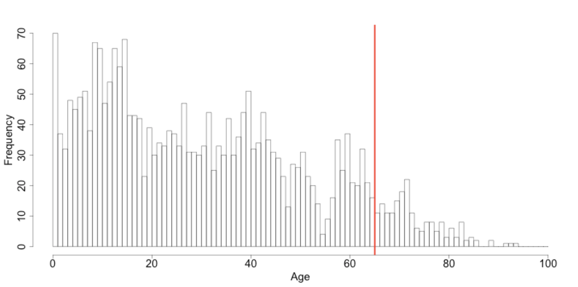
Top and Bottom Coding
Groups the highest/lowest values of a continuous variable into one category
Often used on outliers of long-tail distributions
Screenshot from https://sdctheory.readthedocs.io/en/latest/anon_methods.html#top-and-bottom-coding

Slide 44
Top and Bottom Coding – Example
Birth year: Top code every year later than 2004 to 2005
Income: Top code every income above 100k
Occupation | Birth year | Income
Professor | 1960 | 44361
Researcher | 1961 | 49544
Investor | 1962 | 349822
Professor | 1963 | 503389
Student | 1964 | 83923
Researcher | 1965 | 39562
Software Engineer | 2008 | 35279
Student | 2005 | 32845
Investor | 2007 | 39804
Occupation | Birth year | Income
Professor | 1960 | 44361
Researcher | 1961 | 49544
Investor | 1962 | >100000
Professor | 1963 | >100000
Student | 1964 | 83923
Researcher | 1965 | 39562
Software Engineer | 2005 | 35279
Student | 2005 | 32845
Investor | 2005 | 39804
Occupation | Birth year | Income
Professor | 1960 | 44361
Researcher | 1961 | 49544
Investor | 1962 | 100000
Professor | 1963 | 100000
Student | 1964 | 83923
Researcher | 1965 | 39562
Software Engineer | 2005 | 35279
Student | 2005 | 32845
Investor | 2005 | 39804
Recode

Slide 45
Rounding
Round values to a given base (e.g. 10, 100, 1k, 10k)
Other types of rounding can also be used (e.g. truncating, round up/down)
Similar to recoding: it reduces the number of categories
Income: Round to closest 10k
Occupation | Birth year | Income
Professor | 1960 | 44361
Researcher | 1961 | 49544
Investor | 1962 | 349822
Professor | 1963 | 503389
Student | 1964 | 83923
Researcher | 1965 | 39562
Software Engineer | 2008 | 35279
Student | 2005 | 32845
Investor | 2007 | 39804
Occupation | Birth year | Income
Professor | 1960 | 40k
Researcher | 1961 | 50k
Investor | 1962 | 350k
Professor | 1963 | 500k
Student | 1964 | 80k
Researcher | 1965 | 40k
Software Engineer | 2005 | 40k
Student | 2005 | 30k
Investor | 2005 | 40k
Recode

Slide 46
Local Suppression
Suppresses (removes) some values in the dataset
From the user’s point of view, suppressed values can be anything
They act like wildcards
Calculating f_{k} becomes more complicated when the dataset contains missing values
Region | Birth year | Occupation | f_{k}
A | 1960 | Professor | 1
A | 1965 | Researcher | 1
A | 1960 | Researcher | 1
B | 1960 | Professor | 1
B | 1960 | Researcher | 1
B | 1965 | Professor | 1
Region | Birth year | Occupation | f_{k}
A | 1960 | <NA> | 4
A | <NA> | Researcher | 3
A | 1960 | Researcher | 3
<NA> | 1960 | Professor | 2
B | 1960 | Researcher | 1
B | 1965 | Professor | 1
Suppress

Slide 47
Local Suppression – Algorithms
Algorithms aim for a given level of protection with as few suppressions as possible
Example: Suppress the dataset until it satisfies 2-anonymity
Algorithms naturally tend to suppress:
Variables with many different categories
Infrequent values
Region | Birth year | Occupation | f_{k}
A | 1960 | Professor | 1
A | 1960 | Researcher | 1
A | 1960 | Investor | 1
A | 1960 | Dentist | 1
B | 1960 | Professor | 1
B | 1965 | Professor | 1
Region | Birth year | Occupation | f_{k}
A | 1960 | <NA> | 4
A | 1960 | <NA> | 4
A | 1960 | <NA> | 4
A | 1960 | <NA> | 4
B | <NA> | Professor | 2
B | <NA> | Professor | 2
Suppress

Slide 48
Anonymization Methods — Overview
Anonymization method | Classification | Data type
Remove variables | Non-perturbative, deterministic | Continuous and categorical
Global recoding | Non-perturbative, deterministic | Continuous and categorical
Top and bottom coding | Non-perturbative, deterministic | Continuous
Rounding | Non-perturbative, deterministic | Continuous
Local suppression | Non-perturbative, deterministic | Categorical
PRAM | Perturbative, probabilistic | Categorical
Micro aggregation | Perturbative, probabilistic | Continuous
Noise addition | Perturbative, probabilistic | Continuous
Rank swapping | Perturbative, probabilistic | Continuous
Shuffling | Perturbative, probabilistic | Continuous

Slide 49
PRAM
Probabilistic method that changes the values according to a transition matrix P
To region
 | 0.8 | 0.1 | 0.1
 | 0 | 0.9 | 0.1
 | 0 | 0 | 1
 | A | B | C
A | 0.8 | 0.1 | 0.1
B | 0 | 0.9 | 0.1
C | 0 | 0 | 1
From region
P =
Region | Occupation
A | Professor
A | Researcher
A | Investor
B | Professor
B | Researcher
Region | Occupation
A | Professor
A | Researcher
A | Investor
B | Professor
B | Researcher
A | Professor
PRAM
B | Researcher
A | Investor
B | Professor
C | Researcher

Slide 50
PRAM – Risk Measurement
PRAM does not reduce risk by increasing the key frequencies (f_{k})
This is the case for all perturbative anonymization methods
An attacker may believe that he has identified an individual
However, in reality, the matching may be incorrect
Region | Occupation
A | Professor
A | Researcher
A | Investor
B | Professor
B | Researcher
Region | Occupation
A | Professor
B | Researcher
A | Investor
B | Professor
C | Researcher
Region: B
Occupation: Researcher
PRAM

Slide 51
PRAM
PRAM may produce impossible/unlikely variable combinations (e.g. pregnant men)
This should be checked before release
If impossible combinations occur, then the method must be reconsidered.
Transition matrix should be provided to researchers together with the anonymized dataset
This allows them account for the uncertainty provided by PRAM, and to not make false conclusions

Slide 52
Microaggregation
Split records into groups with similar records
Replace their value with an aggregation of the values in the group
mean(40k, 50k, 50k, 60k) = 50k
mean(90k, 100k) = 95k
Region | Income
A | 40k
A | 50k
A | 50k
A | 60k
B | 90k
B | 100k
Region | Income
A | 50k
A | 50k
A | 50k
A | 50k
B | 95k
B | 95k
Microaggregate

Slide 53
Microaggregation
Split records into groups with similar records
Replace their value with an aggregation of the values in the group
median(40k, 50k, 50k,) = 50k
median(60k, 90k, 100k) = 90k
Region | Income
A | 40k
A | 50k
A | 50k
A | 60k
B | 90k
B | 100k
Region | Income
A | 50k
A | 50k
A | 50k
A | 90k
B | 90k
B | 90k
Microaggregate

Slide 54
Microaggregation
Most suited for continuous data, but can be extended to categorical data
Grouping can be based on the same variable, or other variables
Groups can be of any size
Groups of the same size is often desired
Large groups usually gives better protection than small groups
Useful aggregation functions:
Mean
Median
Mode

Slide 55
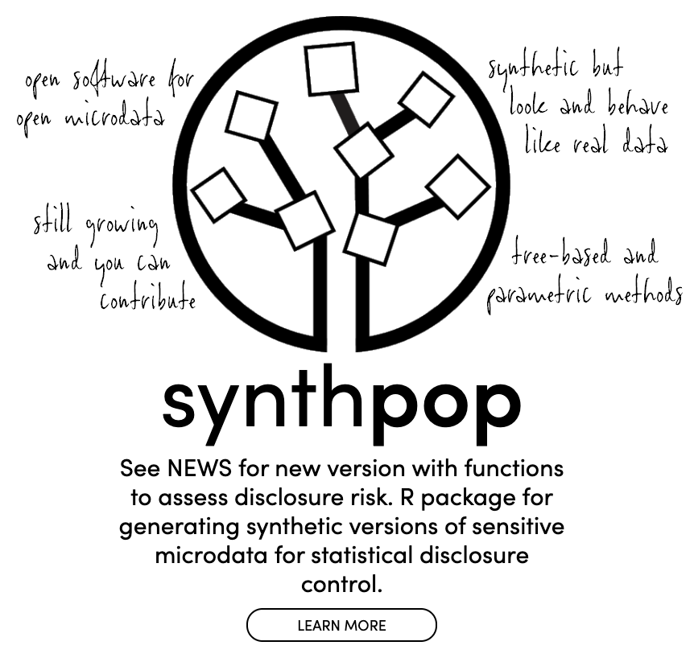
Synthetic Datasets
Alternative: generate synthetic dataset based on the original dataset
R package: synthpop

Slide 56
Utility Measures

Slide 57
Statistical Disclosure Control (SDC) for Microdata
Apply
Anonymization Methods
Evaluate
Risk
Evaluate
Utility

Slide 58
Utility
Measure how useful the released data is
The opposite of utility is information loss (IL)
What is the use case?
There is exactly one use case
There are many use cases
There is no known use case

Slide 59
Utility: One Use Case
Use anonymization methods (and parameters) that suits the use case
Examples:
Remove variables that will not be used
Recode to categories that are useful
Prioritize the most important variables when using local suppression
Make fewer changes to important variables when using PRAM

Slide 60
Utility: Multiple Use Cases
Release multiple datasets
This can be risky! Multiple datasets can be combined to disclose information
Requires more effort
Not recommended!
Try to make one dataset that suits all the use cases
This can be tricky if the use cases are very different or contradictory
Ignore use cases and use a general utility measure
Easier, but will likely lead to a suboptimal result

Slide 61
Utility: No Known Use Case
Use general utility measures
Compare the dataset before and after anonymization
Examples:
Number of suppressed values (in total or per variable)
Number of changed values (in total or per variable)
Changes in contingency tables
Contingency Table-Based Information Loss (CTBIL)¹
Original
Anonymized
 | A | B | C
M | 5 | 4 | 8
F | 4 | 5 | 7
 | A | B | C
M | 5 | 0 | 8
F | 2 | 9 | 6
1) Disclosure Protection Methods and Information Loss for Microdata, J Josep Domingo-Ferrer and V. Torra

Slide 62
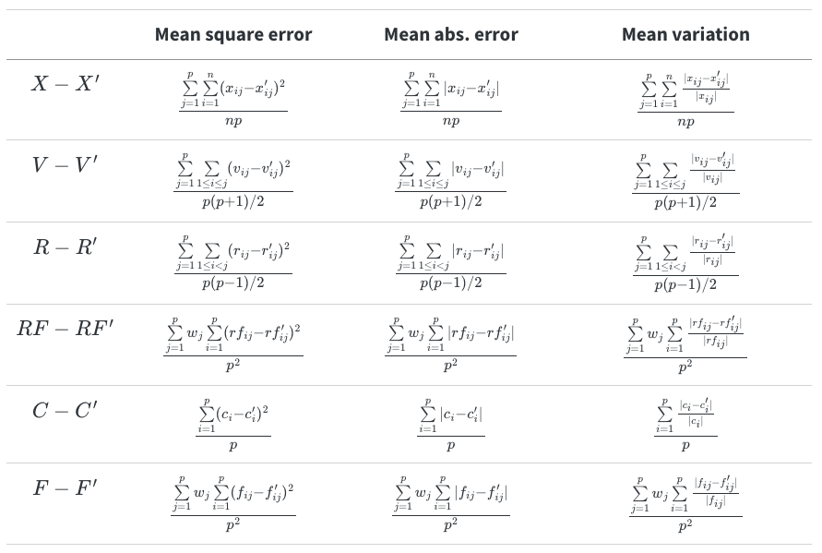
General Utility Measures for Continuous Variables
Disclosure Protection Methods and Information Loss for Microdata, J Josep Domingo-Ferrer and V. Torra

Slide 63
Extra

Slide 64
Households
Multiple individuals belonging to a known group
Additional risks:
Households are easier to detect than individuals
Identifying one individual will likely identify other household members

Slide 65
Next Session

Slide 66
Next Session (Tuesday 25th November)
Focus on R package sdcMicro
Overview of the package
Live coding
Exercises
GUI for sdcMicro
Please be prepared to use sdcMicro on your own computer
Install R (and RStudio)
Download and install sdcMicro from CRAN
Download the course folder from GitHub
Check that the setup is complete by running R/check_before_course.R

Slide 67
Thank you!

